Slide 1
CSP2104 Object-Oriented Programming in C++
Module 6
Understanding Pointers and References + Standard Template Library Containers

Slide 2
On the Agenda…
Limitations of C++ Arrays
Pointers and memory addresses
Creating dynamic containers using pointers
Standard Template Library containers

Slide 3
Limitations of C++ Arrays
Arrays store a container of data elements, each of the same type.
Arrays are simple to use and understand:
int x[4] = {1,2,3,4};
The main limitations are:
Static Size: Once created we cant change the size of the array.
Allocated at Compile Time, so cant create an array where the size is only known at run-time.

Slide 4
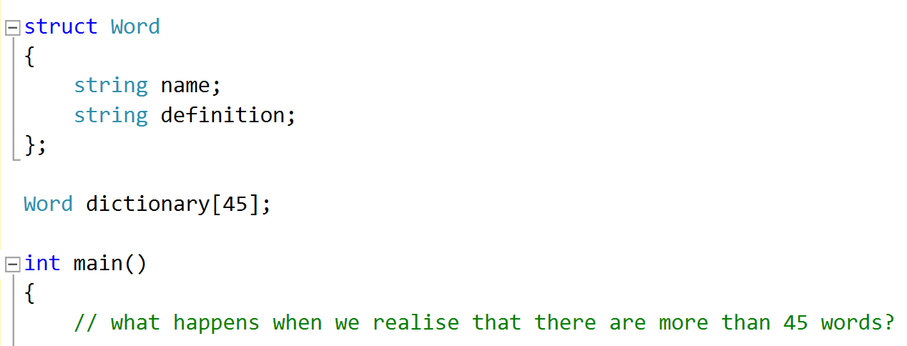
Limitations of C++ Arrays
Static Size - Consider:
Can get around this by creating a really large array so that we wont run out of space for new words…. Maybe not the best use of memory?

Slide 5
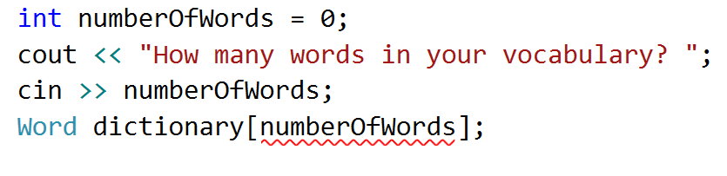
Limitations of C++ Arrays
Allocated at Compile Time - Consider:
Error: ‘Expression must have a constant value’ – i.e. The number of elements to create must be known at the point where the program is compiled, rather than being set at runtime.

Slide 6
Limitations of C++ Arrays
So in applications where we need a container of things that grows and shrinks, the array is not the best option.
Some options:
Learn about C++ memory management and create our own dynamic container structure.
Use a dynamic container structure that someone has already created – there are some in the C++ Standard Template Library.

Slide 7
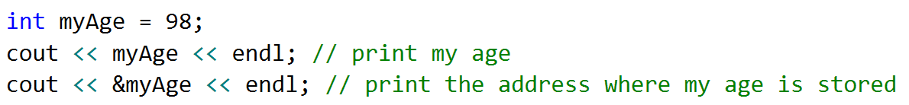
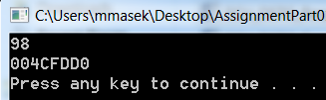
Understanding Memory Addresses
Each location where a piece of data can be stored is identified by a variable name and its memory address
The location can be accessed by using the & operator – called the address of operator.

Slide 8
Understanding Memory Addresses
The address of operator is useful for passing things ‘by reference’:
Calling a function/method where the input is the address of the data we want it to operate on – we examine this when we deal with functions.
Useful for implementing container classes where we store the adress of each element in the container, rather than making a copy of the element to store.

Slide 9

Understanding Pointers
When wanting to work with memory, an alternative to using the address of operator is to use ‘pointers’.
The symbol ‘*’ is used – read as ‘pointer to’ (when talking about the address) or ‘star’ (when talking about the value)
Note: The above code does not allocate any memory – year or *year cant be used yet!
Notes:
Keep in mind, whenever you use &, don’t use * and vice versa.

Slide 10

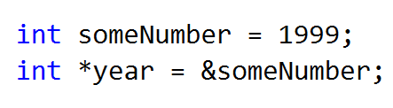
Understanding Pointers
A pointer variables can not be directly initialised with a literal value as no memory has been allocated to store that value:
A ‘safe’ way around it is to pass it a value already in memory:
This is ‘safe’ because when someNumber goes out of scope, its memory is freed.
Notes:
Keep in mind, whenever you use &, don’t use * and vice versa.

Slide 11
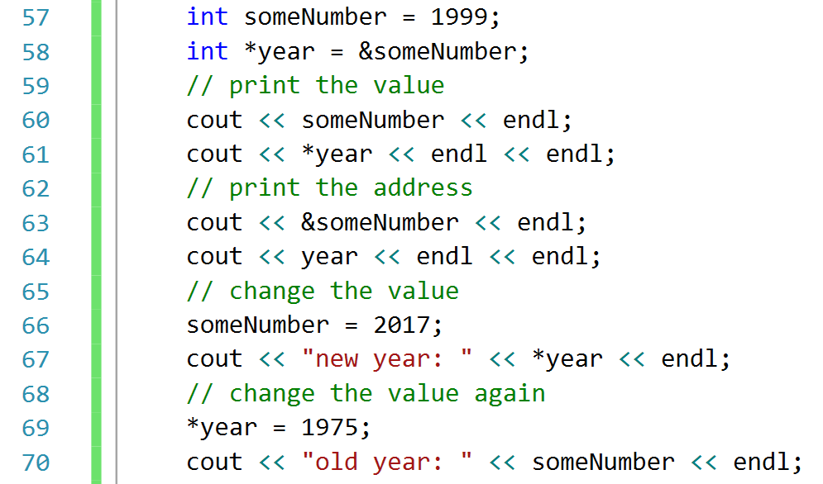
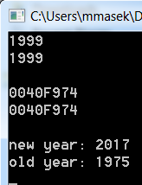
Understanding Pointers
Note the equivalence mapping of pointer and address-of notation
Notes:
Keep in mind, whenever you use &, don’t use * and vice versa.

Slide 12
Understanding Pointers
Note there is only one instance of the value in memory - &someNumber and year are the same address! So changing the value changes it for both variables….
Notes:
Keep in mind, whenever you use &, don’t use * and vice versa.

Slide 13
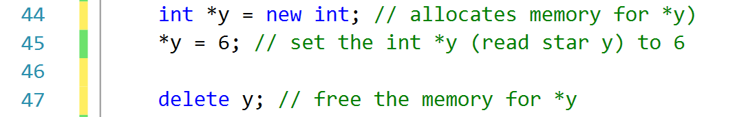
Understanding Pointers
An alternative to assigning values when you don’t want to assign an existing variable – the new keyword.
The new keyword allocated memory.
Important! When the pointer goes out of scope the value become inaccessible – but memory is not released - a memory leak. If you allocate memory using new, you need to release it using delete.
Notes:
Keep in mind, whenever you use &, don’t use * and vice versa.

Slide 14
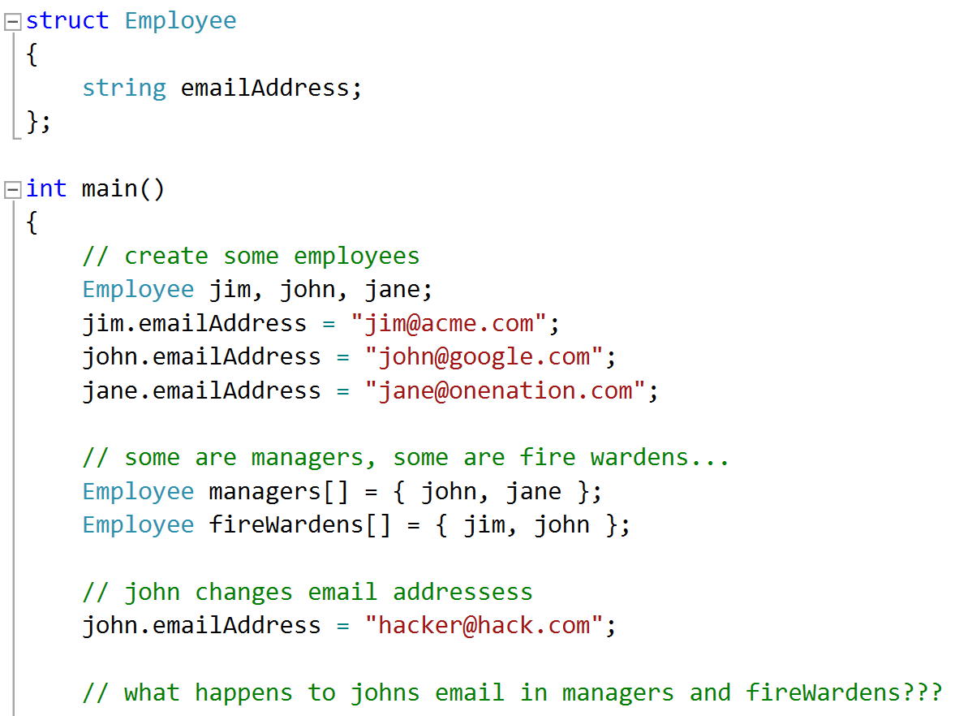
Example Application
Consider this code. A number of employees, some can be managers, some can also be fireWardens (tracked using an array). Then John changes his email address:
Notes:
Copies of variables are made here and put into the managers and fireWardens arrays. When the original variable changes the change is not reflected in the copy that is in the array.

Slide 15
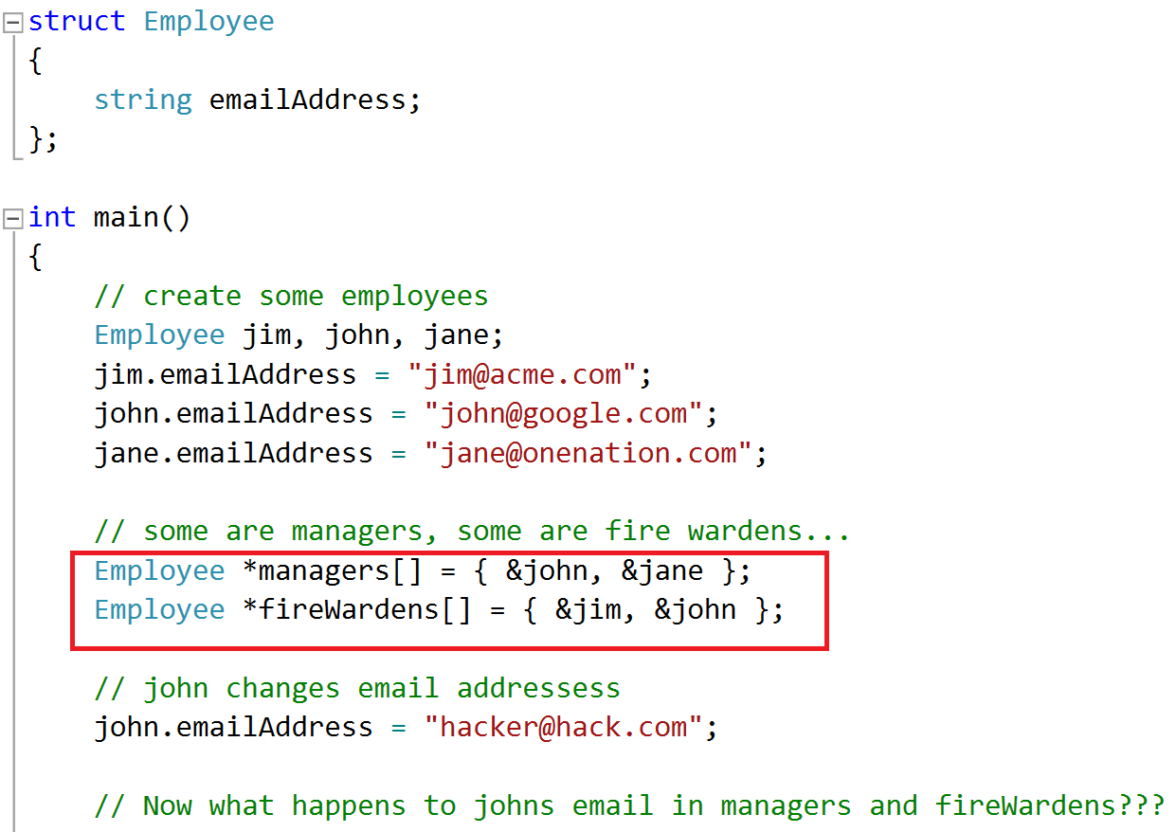
Example Application
This can be fixed by using only one instance of each employee, rather than making copies:
Since we don’t use new, we don’t need delete
Notes:
The code has changes, now the arrays are not of Employees but references to Employees – no copy is made, the array holds the memory address of the original variables. In this version John’s email address is updated in the managers and fireWardens arrays.

Slide 16
Example: Using a Pointer Instead of an Array Name
#include <iostream>
using namespace std;
int main() {
const int DAYS = 7;
int sales[DAYS] = {500, 300, 450, 200, 525, 800, 1000};
int* p = sales;
int x;
for (x = 0; x < DAYS; ++x)
cout << “$” << sales[x] << “ “;
cout << endl;
for (x = 0; x < DAYS; ++x)
cout << “$” << p[x] << “ “;
cout << endl;
for (x = 0; x < DAYS; ++x)
cout << “$” << *(sales + x) << “ “;
cout << endl;
for (x = 0; x < DAYS; ++x)
cout << “$” << *(p + x) << “ “;
cout << endl;
for (x =0; x < DAYS; ++x, ++p)
cout << “$” << *p << “ “;
cout << endl;
system(“pause”);
return 0;
}

Slide 17
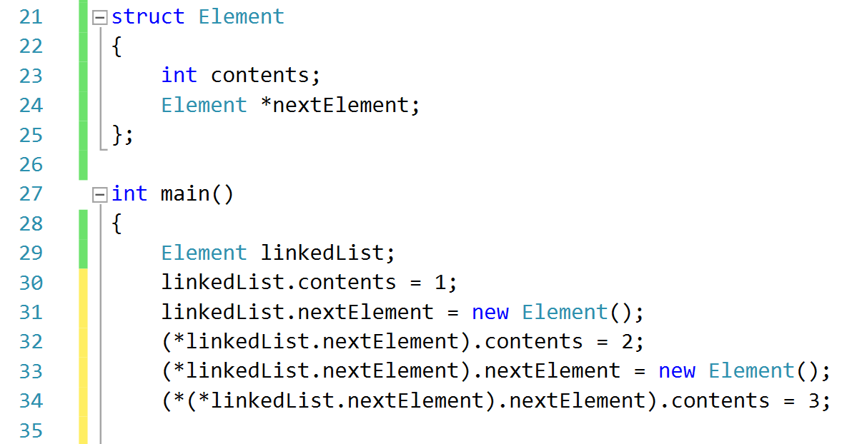
Back to Limitations of C++ Arrays
Back to our original problem… the limitations of arrays in C++
Static and Size must be known at compile time.
Solution: Linked lists. Each element has a pointer to the next. Use new and delete to grow and shrink list.

Slide 18
Back to Limitations of C++ Arrays
Back to our original problem… the limitations of arrays in C++
Static and Size must be known at compile time.
Solution: Linked lists. Each element has a pointer to the next. Use new and delete to grow and shrink list.

Slide 19
Back to Limitations of C++ Arrays
A rough example of creating a linked list of integers.
To do this ‘nicely’ enrol in a data structures unit.
Don’t forget to delete everything created using new (when you no longer need it).

Slide 20
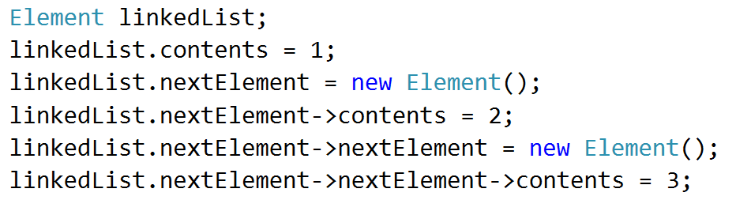
Simpler pointer notation for structs and classes
Writing (*structInstance).structMember is tedious
A shortcut syntax for this is
structInstance->structMember
Equivalent

Slide 21
Back to Limitations of C++ Arrays
To implement the linked list properly, we would need to keep a pointer to the end of the list, and add a methods to add, delete and retrieve elements whilst hiding the complex code.
But using dynamic containers is so common, that somebody has done it for us….

Slide 22
Introduction to the Standard Template Library
The Standard Template Library (STL) defines template-based reusable components
Provides containers, iterators and algorithms
Example: vector is a sequence container
A vector is similar to an array, except:
No need to declare the number of elements
Automatically increases size as needed
Has simpler syntax to retrieve number of elements
Some useful vector methods include
at(int), push_back(value), pop_back(), size(), clear(), empty()

Slide 23
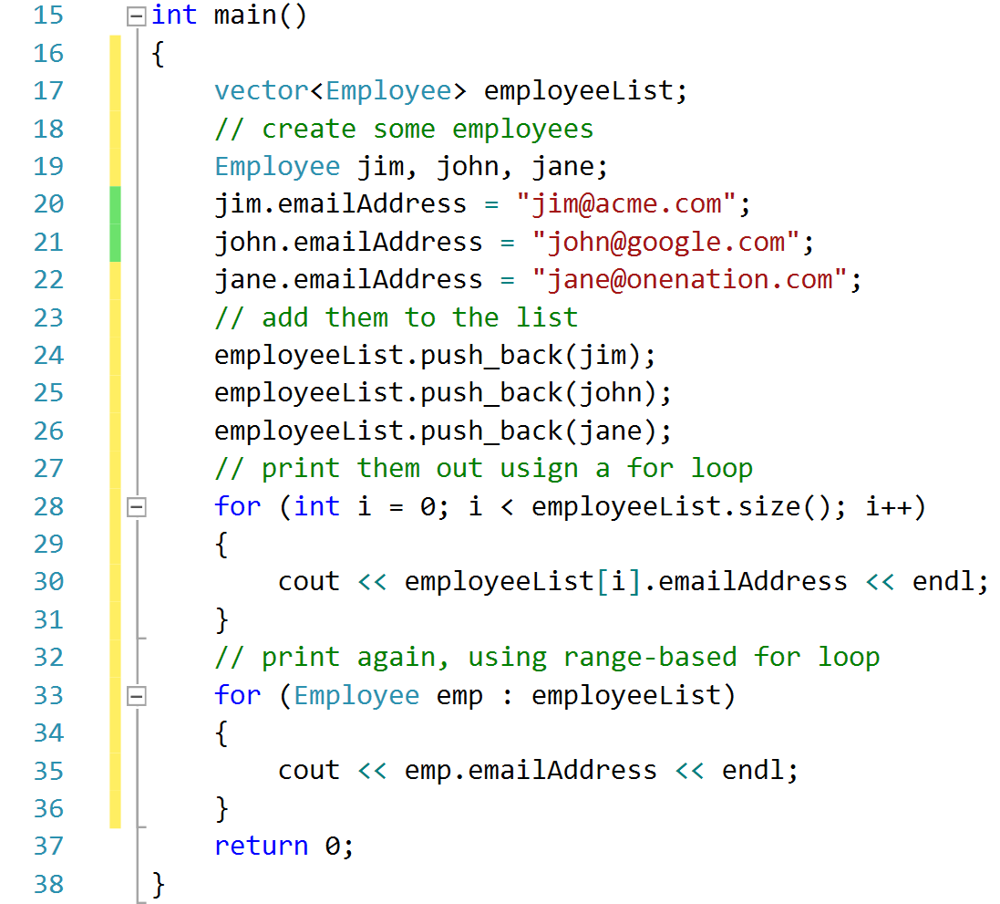
Introduction to the Standard Template Library

Slide 24
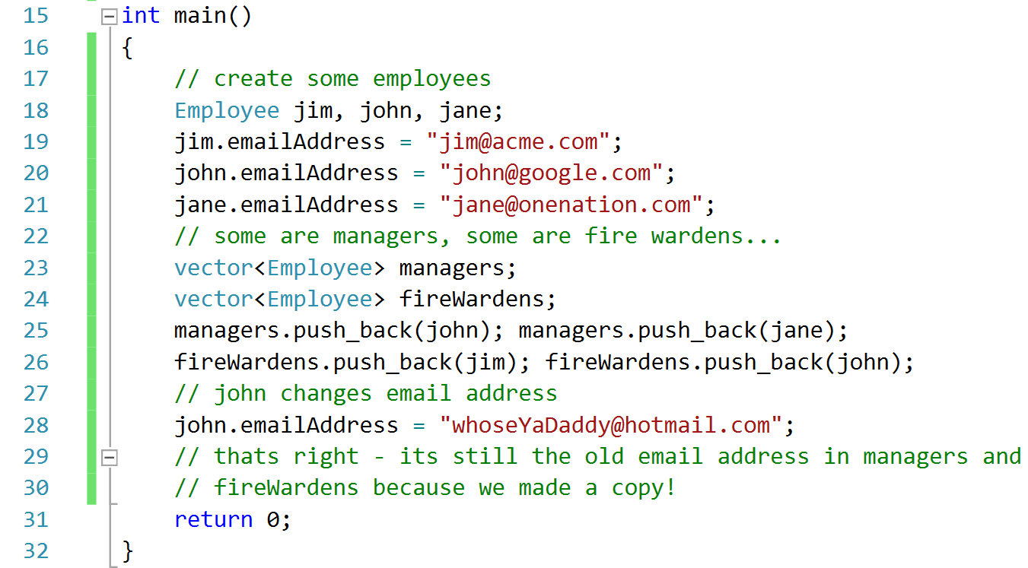
Introduction to the Standard Template Library
So now we can create dynamic containers, with as many elements as we want. But back to an old problem…

Slide 25
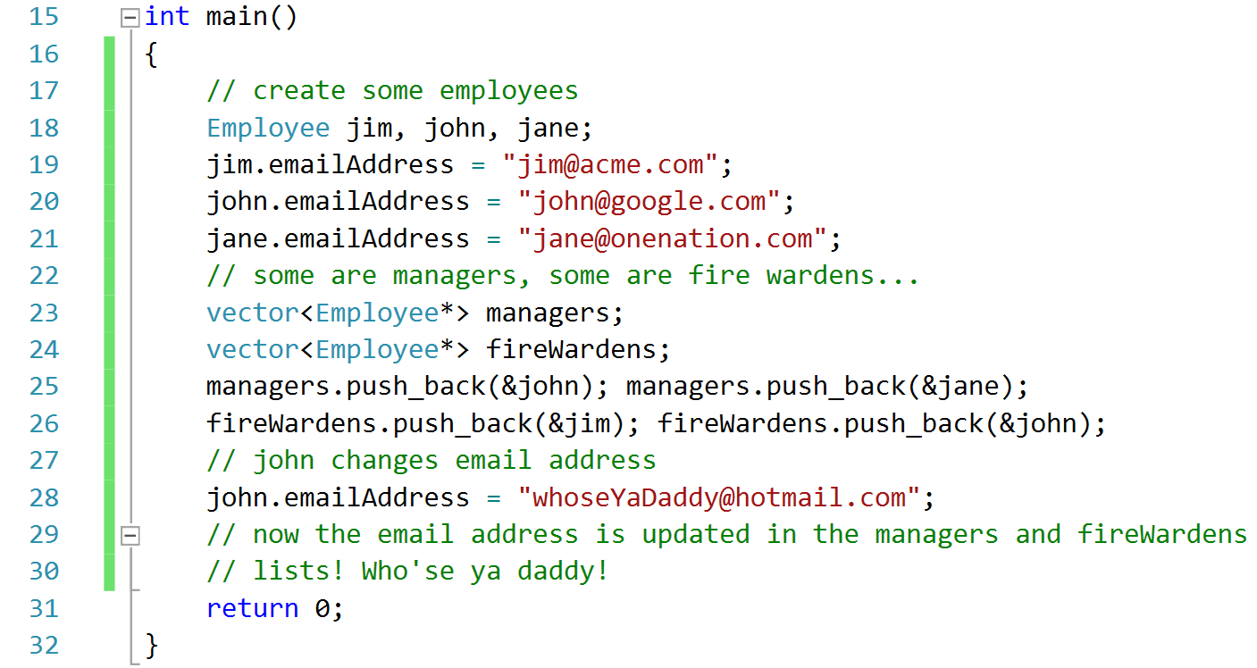
Introduction to the Standard Template Library
The solution is the same, store pointers rather than actual copies of the variables…
Note addition of * and &

Slide 26
Example Usage
Inserting an element into a vector using iterators and the insert() function
Useful functions for inserting elements
push_back(), begin(), end(), insert(position, value)
Example
nums.insert(nums.begin() + 2, 15);
Sorting vector elements using the sort() algorithm
The sort() algorithm arranges a vector in ascending order
Must have #include <algorithm>
Elements are sorted in order depending on how the < is defined for the data type
Example
sort(myVector.begin(), myVector.end();
Use reverse() to produce a list in reverse order

Slide 27


